Slide 1

Keyless Kingdom A cloud solution: Raspberry Pi & RFID Open Doors to the Future!
Matthew Mendoza for CSC 196P: Cloud and Mobile Pragmatics

Slide 2
Breaking Boundaries A cloud solution: Raspberry Pi + RFID = Your Passport to Innovation!
Matthew Mendoza for CSC 196P: Cloud and Mobile Pragmatics

Slide 3
Unlocking the Future A cloud solution: Harnessing Raspberry Pi and RFID for Limitless Possibilities!
Matthew Mendoza for CSC 196P: Cloud and Mobile Pragmatics

Slide 4
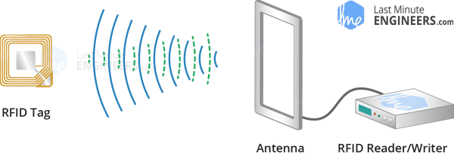
RFID RECAP
What is RFID Technology
How does it work?
RFID (Radio Frequency Identification) is a wireless technology for identifying and tracking objects.
Applications include inventory management, supply chain logistics, access control, and contactless payment systems.
RFID offers advantages like improved inventory accuracy and faster data collection.
It uses electromagnetic fields to communicate between tags and readers.
Tags consist of a microchip and an antenna.
When within range of an RFID reader, the reader sends out radio waves.
These waves power the tag, enabling it to transmit data back to the reader.
Data typically includes unique identifiers or stored information on the tag.
Source: Wikipedia - Radio-frequency identification - Last Minute Engineers - What is RFID? How It Works? Interface RC522 RFID Module with Arduino

Slide 5

The Setup

Slide 6
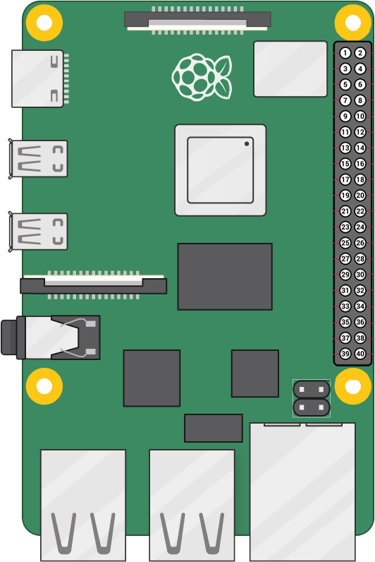
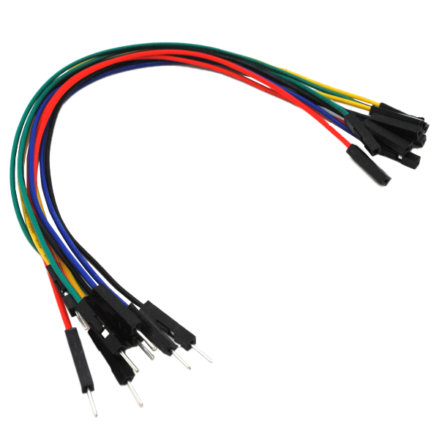
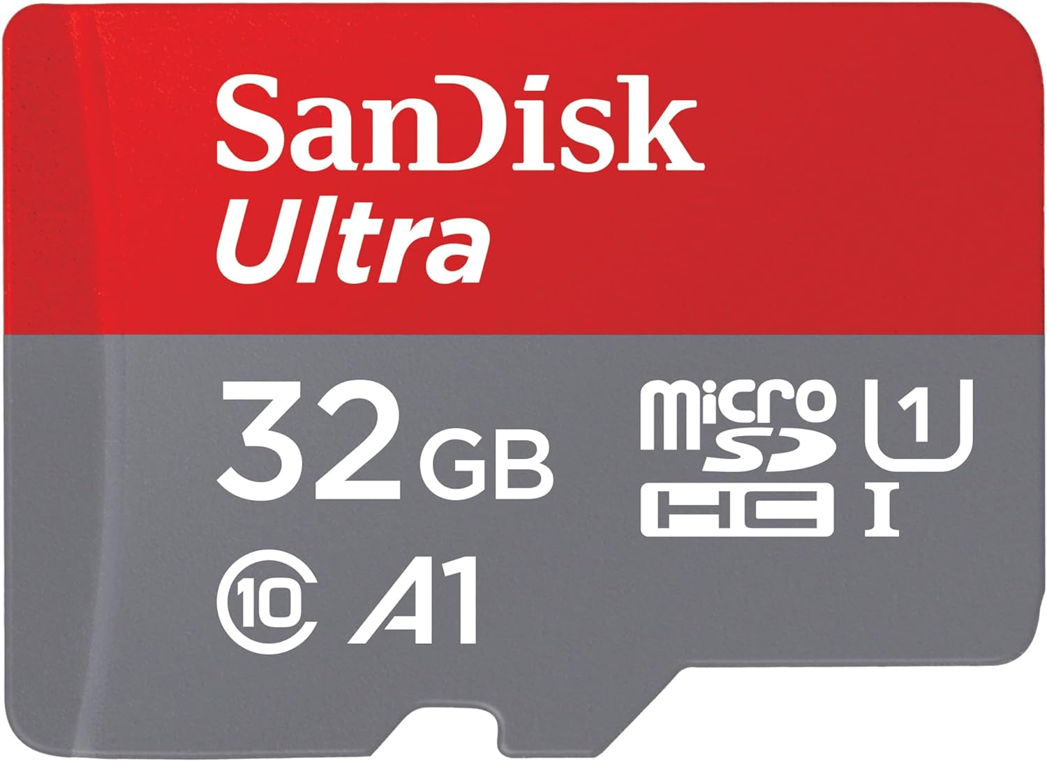
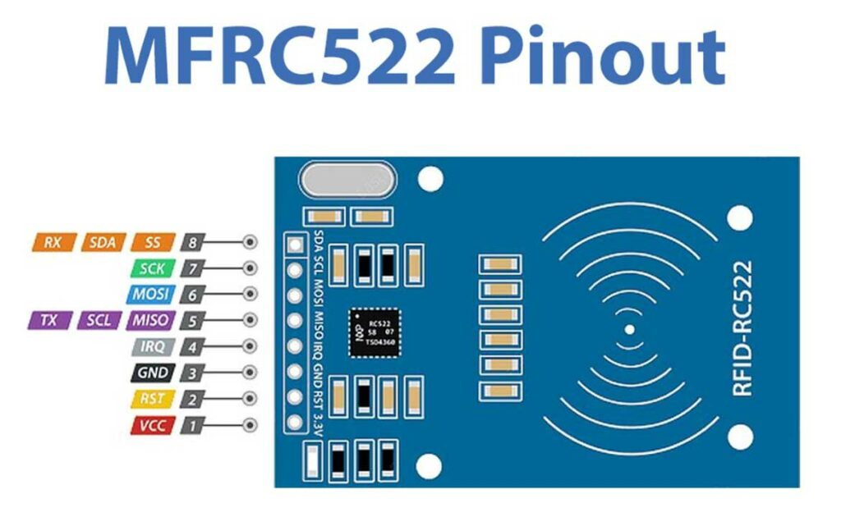
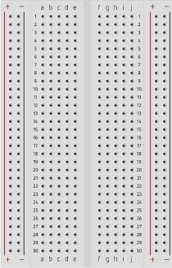


Hardware Components and Accessories
Micro SD Card
Male-Female Jumper Wires
RFID Card Tag
Key Fob Tag
Mifare RC522
Module RFID Reader
Raspberry Pi 4 Model B
Breadboard

Slide 7
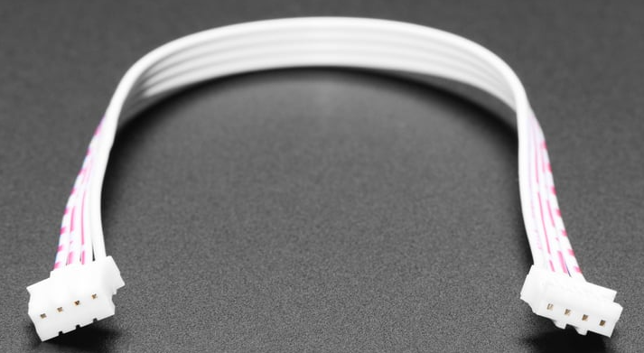
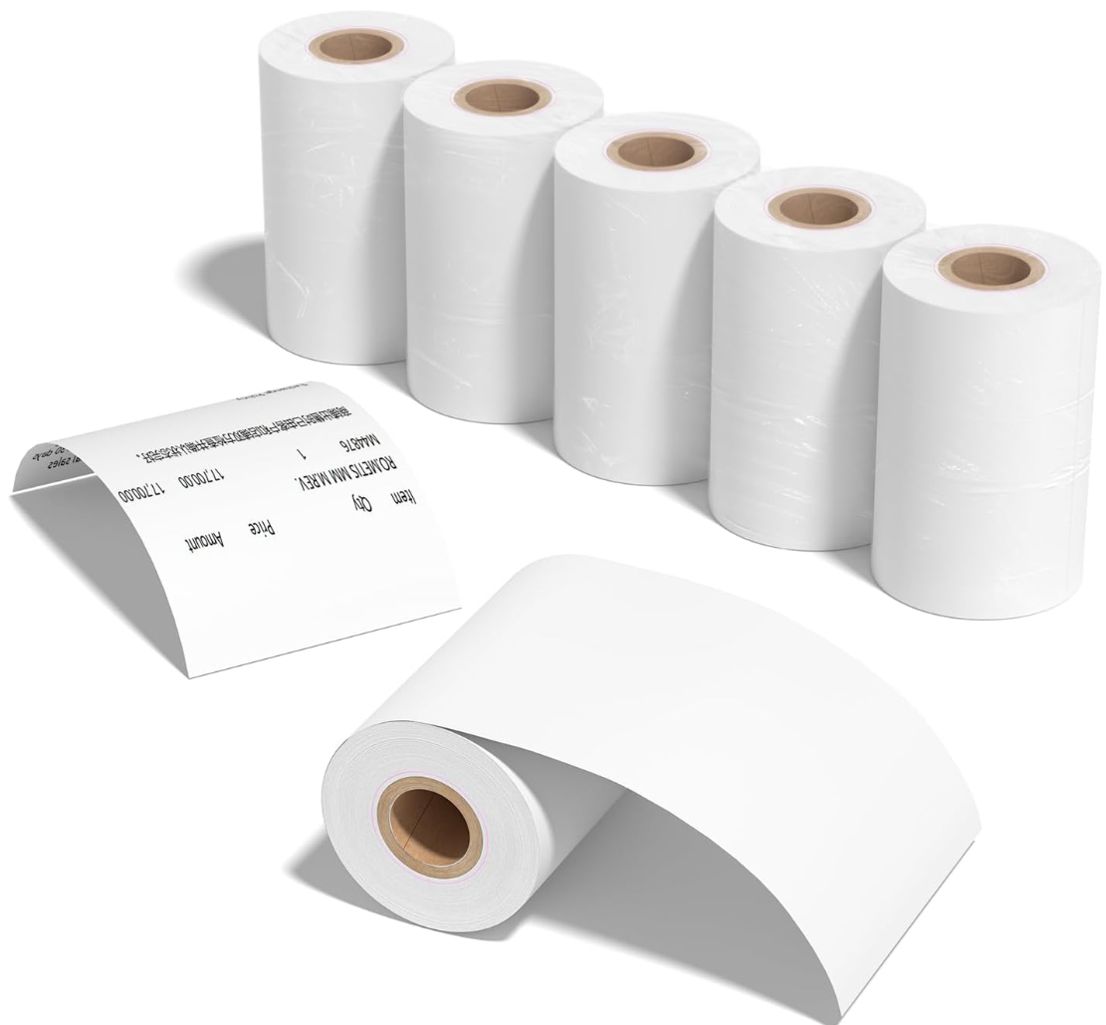
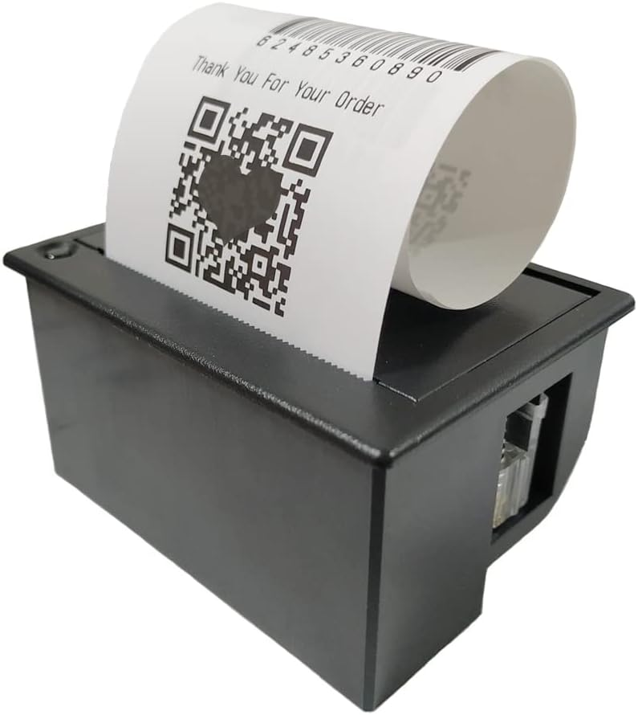
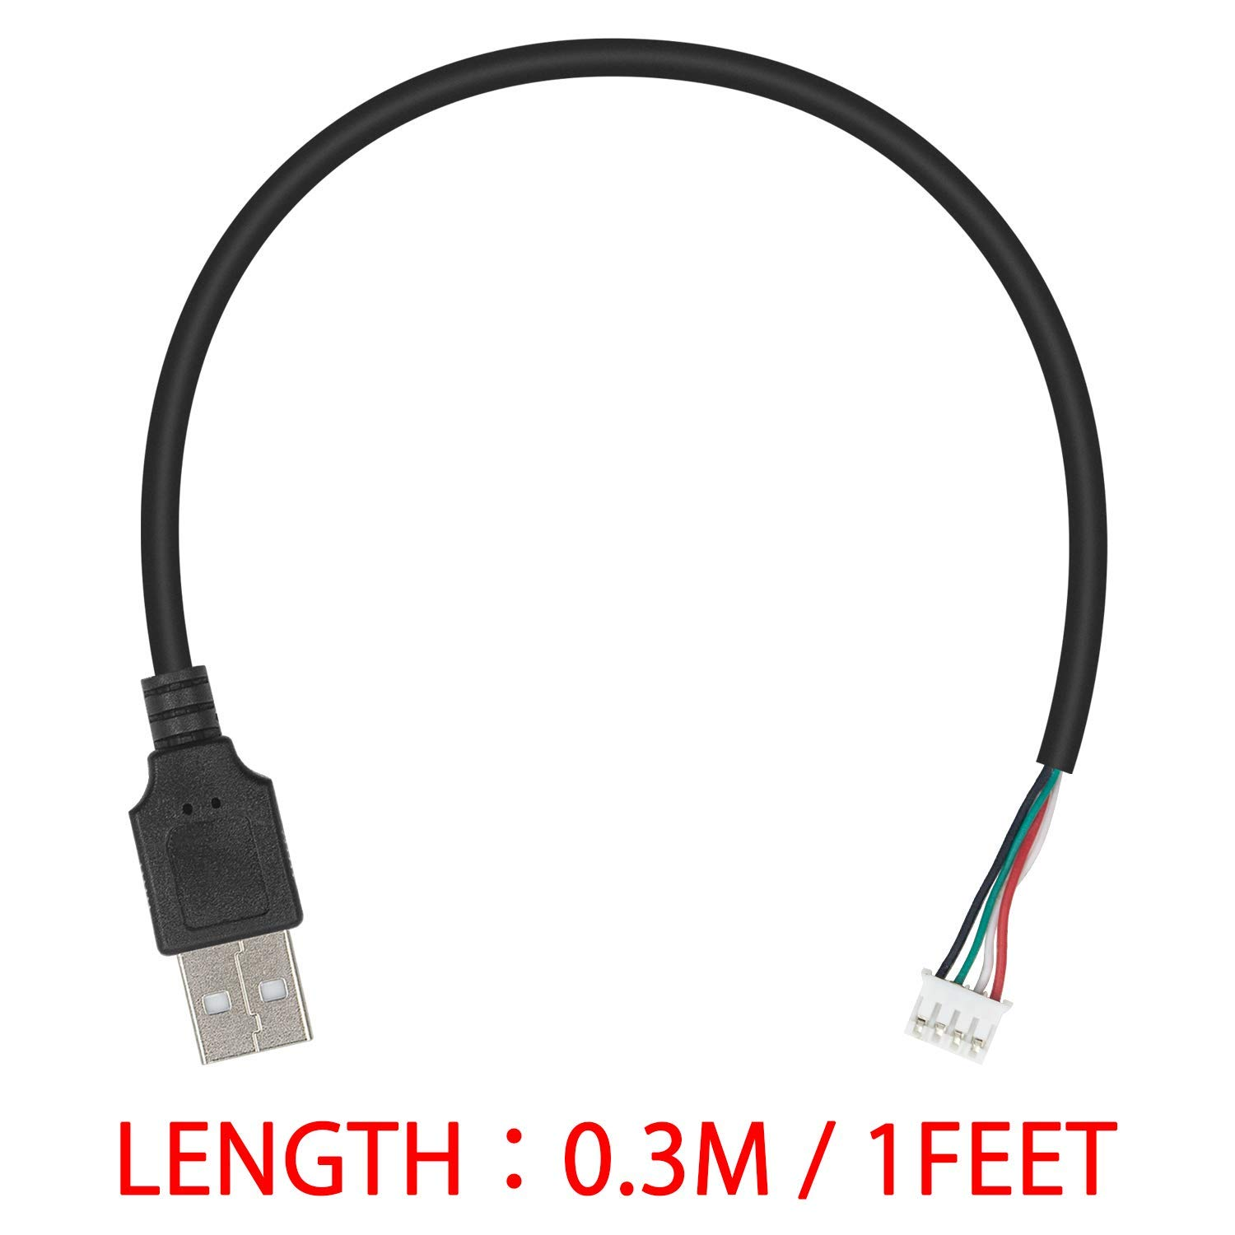
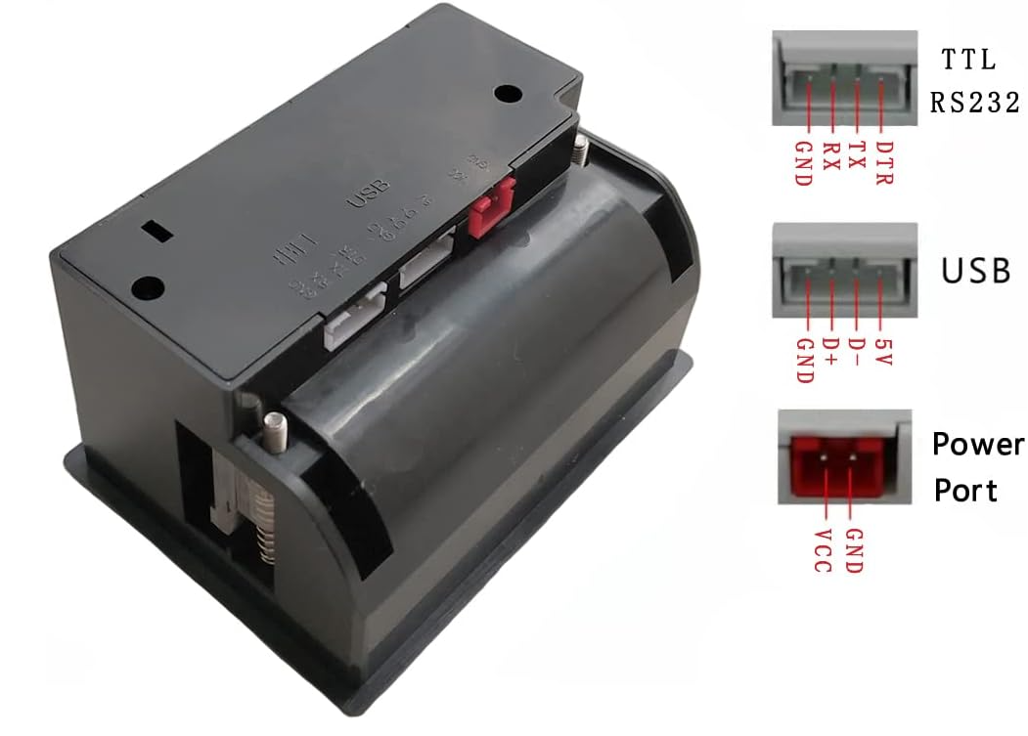
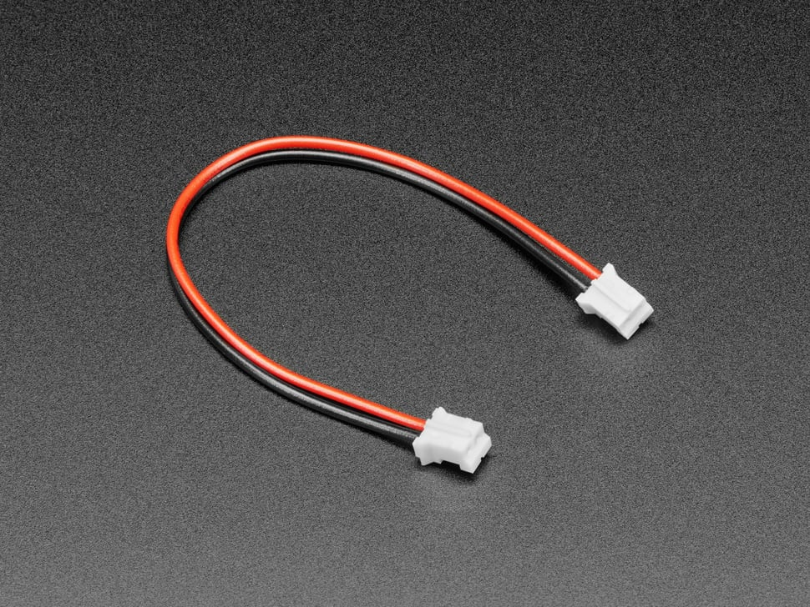
Hardware Components and Accessories
4 PIN Serial Port Line
(STEMMA Cable 4 Pin JST-PH Cable)
Thermal Paper Rolls
57mm (width) x 30mm (roll diameter)
USB 2.0 Male to 4 pin Data Cable
5~9V Embedded Thermal Receipt Printer
(Maikrt Micro Thermal Printer)
2PIN Power Terminal Cable
(JST-PH 2-pin Jumper Cable)

Slide 8

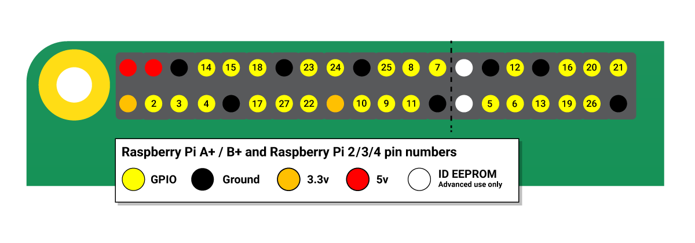
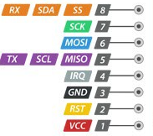
Pinouts
Raspberry Pi GPIO pinout
Raspberry Pi 4 Model B
Mifare RC522Module RFID Reader
Micro Thermal Printer
Source: Raspberry Pi GPIO and the 40-pin header, Interface RC522 RFID Module

Slide 9



Wiring for RFID Reader
RC522 Module (Right to Left) |  | Raspberry Pi
PIN 1: Voltage Common Collector (VCC) | Red | PIN 1: 3.3v
PIN 2: Reset (RST) | Gray | PIN 22: GPIO #25
PIN 3: Ground (GND) | Black | PIN 6: Ground (GND)
PIN 4: Interrupt Request (IRQ) |  | Not connected
PIN 5: Master In Slave Out (MISO) | Blue | PIN 21: GPIO #9 (MISO)
PIN 6: Master Out Slave In (MOSI) | GOLD | PIN 19: GPIO #10 (MOSI)
PIN 7: Serial Clock (SCK) | Orange | PIN 23: GPIO #11 (SCLK)
PIN 8: Serial Data Line (SDA) | Green | PIN 24: GPIO #8 (CE0)
Source: RC522 RFID Tag Reading with the Raspberry Pi
Notes:
RC522 Module PIN 1: Voltage at the Common Collector (VCC) - Used to Power the module, typically 3.3V is used
PIN 2: RST - Reset pin – used to reset or power down the module
PIN 3: Ground - Connected to Ground of system
PIN 5: MISO - used for SPI communication, acts as SCL for I2c and Tx for UART.
PIN 6: MOSI - Master out slave in pin for SPI communication
PIN 7: SCK - Serial Clock pin – used to provide clock source
PIN 8: SDA - Acts as Serial input (SS) for SPI communication, SDA for IIC and Rx during UART

Slide 10
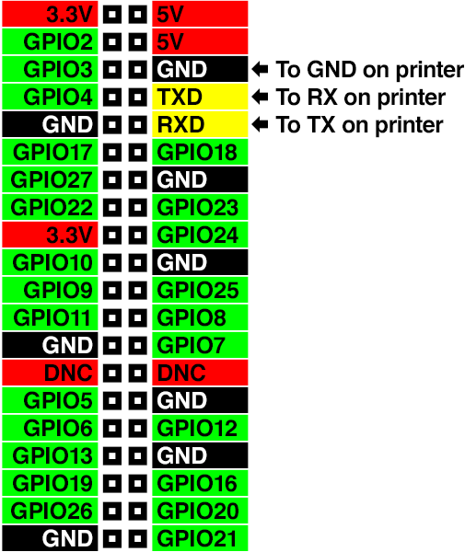
Wiring for Thermal Printer VIA TTL/RS262
Thermal Printer 🖨️ |  | Raspberry Pi
TTL/RS232 - Ground (GND) | Black | Board PIN 6: Ground (GND)
TTL/RS232 - Transmit (TX) | Yellow | Board PIN 8: GPIO 14 (UART Transmit)
TTL/RS232 - Receive (RX) | Green | Board PIN 10: GPIO 15 (UART Receive)
Power Port - Voltage Common Collector (VCC) |  | Board PIN 2/4: 5v Power
Power Port - Ground (GND) |  | Board PIN 9/14: Ground (GND)
Source: Connect and Configure Printer

Slide 11
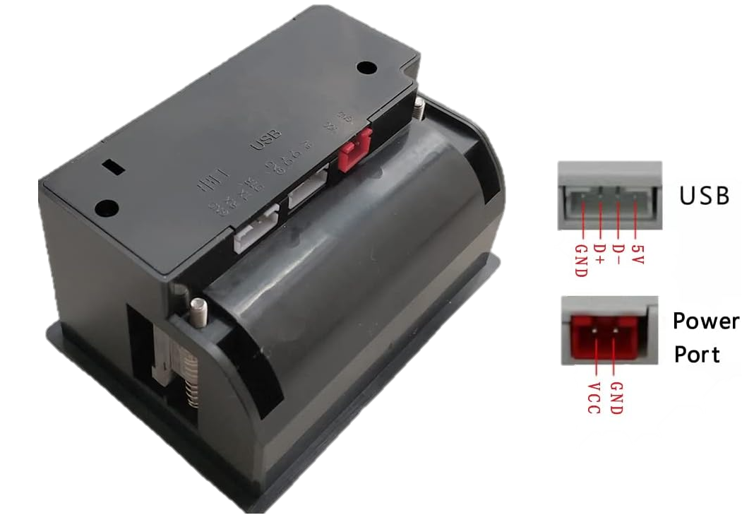
Wiring for Thermal Printer VIA USB
Thermal Printer 🖨️ | Raspberry Pi
Power Port - Voltage Common Collector (VCC) | Board PIN 2/4: 5v Power
Power Port - Ground (GND) | Board PIN 6/9/14: Ground (GND)

Slide 12
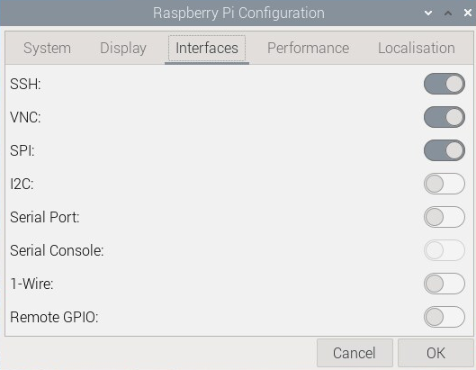
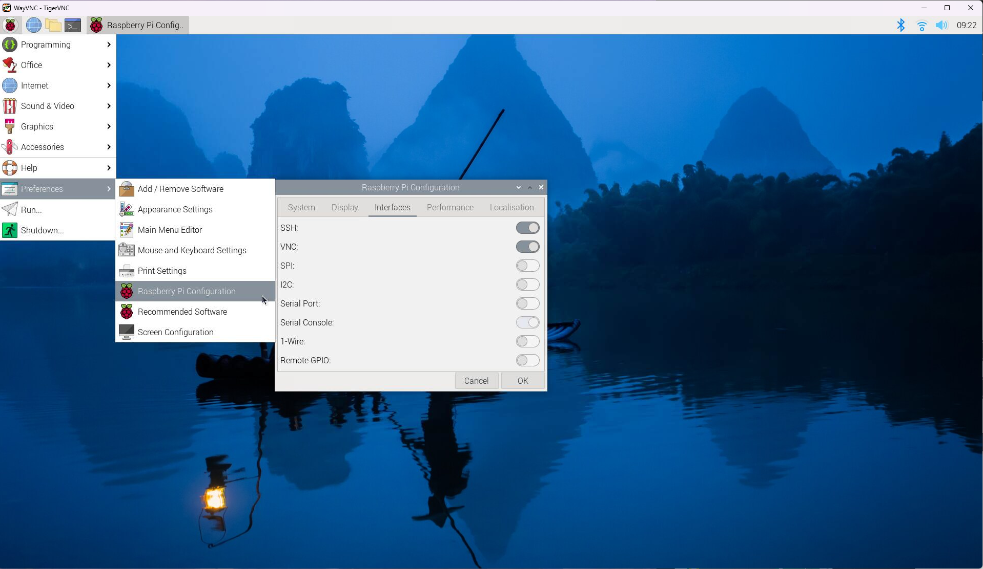
Configure Raspberry Pi for RFID READER (RFIO-RC522)
Enable Serial Peripheral Interface (SPI) connection
an interface bus commonly used to send data between microcontrollers and small peripherals such as shift registers, sensors, and SD cards. It uses separate clock and data lines, along with a select line to choose the device you wish to talk to.
1
2
3
Source: Pinout.xyz: SPI - Serial Peripheral Interface

Slide 13
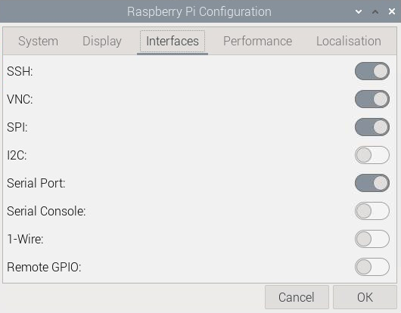
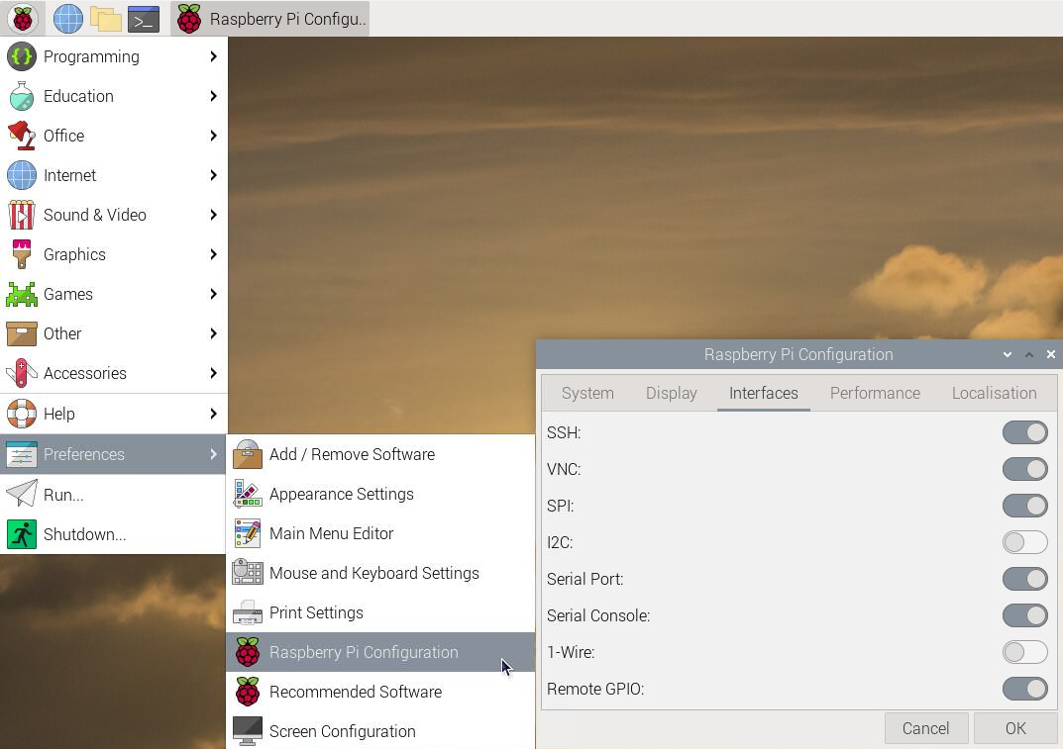
Configure Raspberry Pi for Thermal Printer
Enable UART (Universal Asynchronous Receiver-Transmitter) serial port
useful for various applications, such as communicating with other serial devices like Arduino boards, GPS modules, and other microcontrollers.
1
2
3
Source: pinout.xyz: UART - Universal Asynchronous Receiver/Transmitter

Slide 14
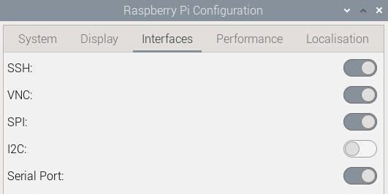
Serial Communication: SPI VS UART
Both communication protocols used for serial communication, but they have different characteristics and applications:
SPI (Serial Peripheral Interface)
UART (Universal Asynchronous Receiver-Transmitter)
Data is transferred in sync with a clock signal.
Typically involves a master device (such as a microcontroller or Raspberry Pi) and one or more slave devices (such as sensors or displays)
Uses separate lines for data (MOSI - Master Out Slave In, MISO - Master In Slave Out), clock (SCLK), and sometimes for chip select (CS) to enable communication with multiple slave devices
Data is transmitted without the need for a shared clock signal
Typically involves two devices communicating with each other using a single data line (TX - Transmit) and a single receive line (RX - Receive), along with a ground reference
UART communication is simpler and more flexible than SPI, but it tends to be slower and less efficient, especially over longer distances or in noisy environments
Unlike SPI, UART communication is not synchronous and does not require a clock signal. It operates using start and stop bits to synchronize data transmission.
Source: SPI (Serial Peripheral Interface), UART (Universal Asynchronous Receiver/Transmitter)

Slide 15


Demo time, lets do it live!

Slide 16


Setting the mood
Interactive Background Noise Generator

Slide 17
Resources
Learning & Tutorials
Hardware/Products Used
https://learn.sparkfun.com/tutorials/serial-communication/wiring-and-hardware
https://pinout.xyz/pinout/uart
https://pinout.xyz/pinout/spi
https://learn.adafruit.com/mini-thermal-receipt-printer/overview
https://learn.adafruit.com/networked-thermal-printer-using-cups-and-raspberry-pi/overview
https://circuitdigest.com/microcontroller-projects/thermal-printer-interfacing-with-raspberry-pi-zero-to-print-text-images-and-bar-codes
Micro Thermal Printer 5~9V Embedded Thermal Receipt Printer Serial Port Microcontroller Secondary Development MCU Printing Module TTL/RS232
57x30mm Thermal Paper White 10 Rolls
JST-PH 2-pin Jumper Cable - 100mm long
Duttek USB to PH2.0 Cable, PH2.0 Female to USB 2.0 Male to 4 pin Data Cable
STEMMA Cable - 4 Pin JST-PH 2mm Cable–Female/Female
SunFounder Reader Module Kit Mifare RC522 Reader Module
For fun/recommended: SunFounder Starter Kit for Raspberry Pi 5

